Slide 1
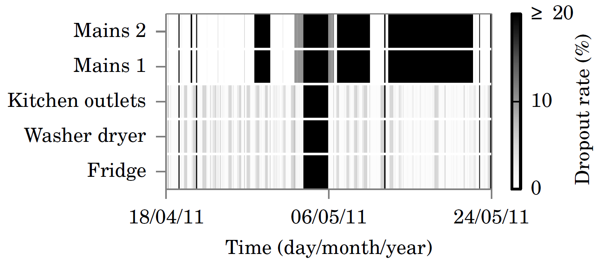
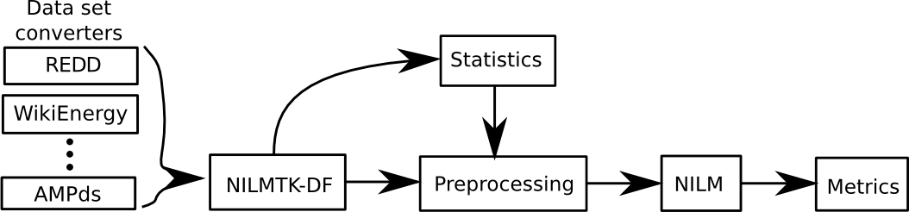
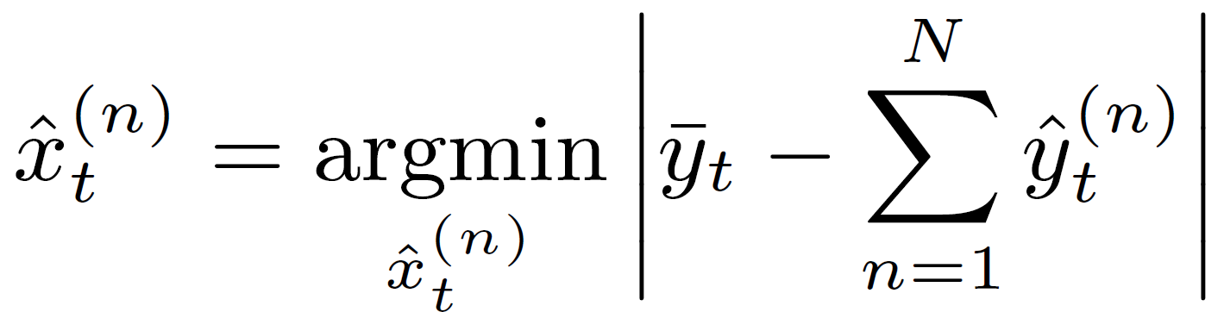
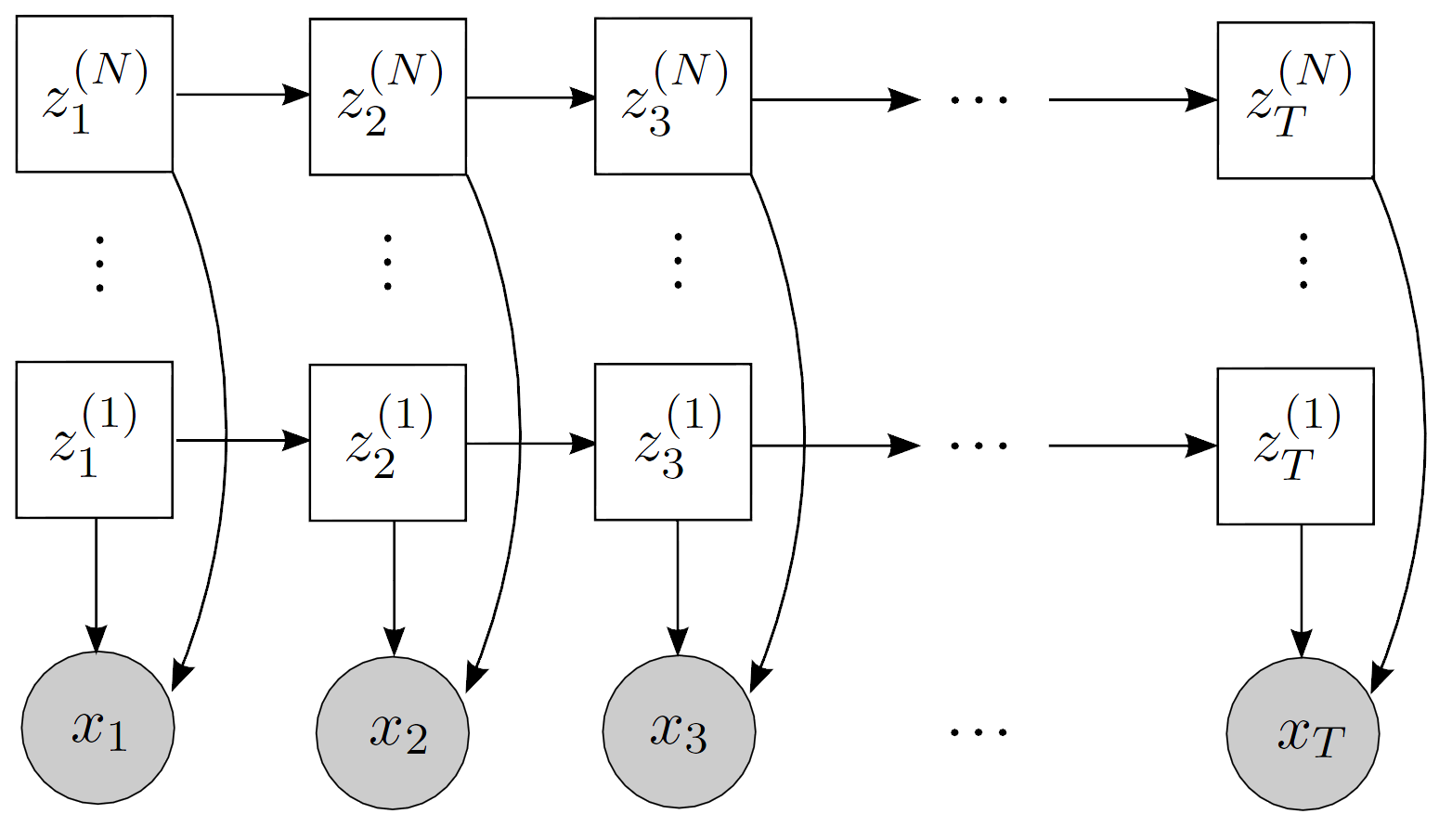
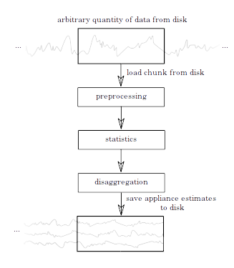
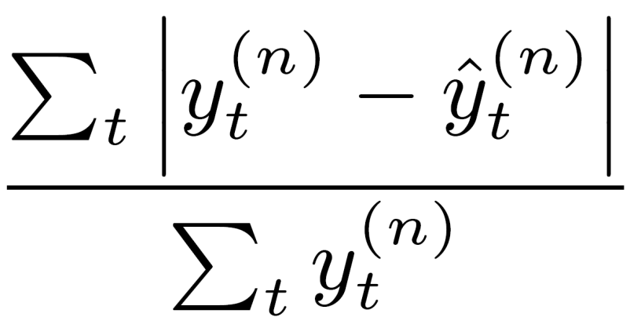
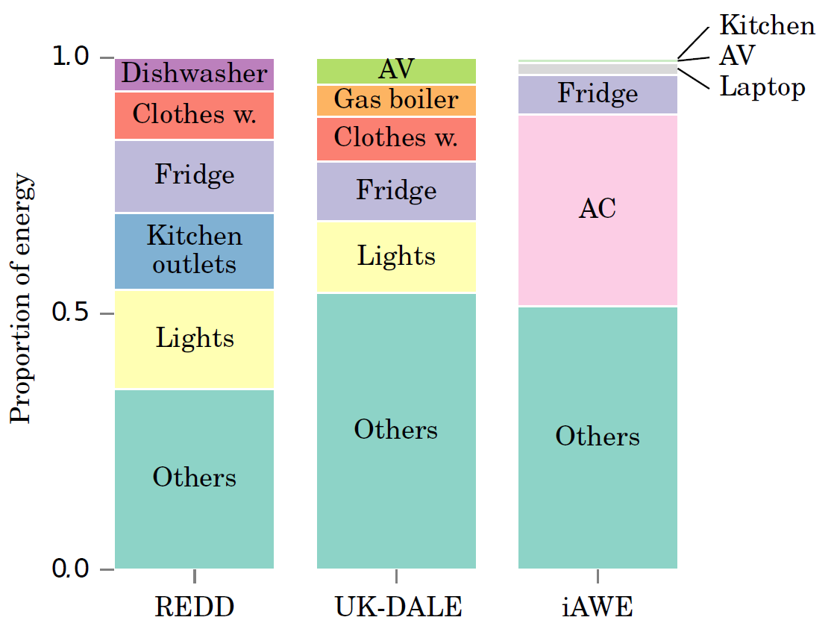
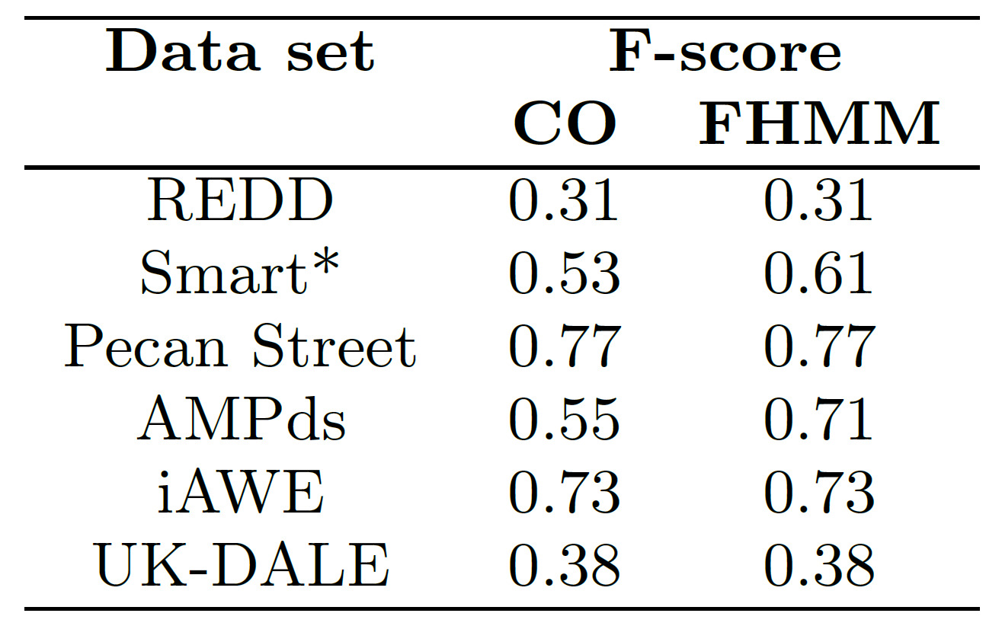





NILMTK v0.2: A Non-intrusive Load Monitoring
Toolkit for Large Scale Data Sets
Jack Kelly¹, Nipun Batra², Oliver Parson³, Haimonti Dutta⁴, William Knottenbelt¹,
Alex Rogers³, Amarjeet Singh², Mani Srivastava⁵
¹Imperial College London, ² IIIT Delhi, ³ University of Southampton, ⁴ CCLS Columbia, ⁵ UCLA
nilmtk.github.io
Problems with NILM research
Data set diagnostics
Different data sets used by each paper
No reference benchmark implementations available
Different metrics used by each paper
Common imperfections in data sets can be identified:
Gaps
Find continuous periods
Dropout rate
Dropout rate ignoring large gaps
Up-time
NILMTK: A toolkit for NILM research
NILMTK offers a complete pipeline from data sets to metrics:
NILMTK defines a file format (NILMTK-DF) for NILM data
Multiple dataset converters are included.
Pipeline includes dataset statistics, preprocessing,
training, disaggregation and NILM metrics.
Benchmark algorithms
Combinatorial optimisation (CO): Finds combination of appliance states which sum to aggregate power demand
Factorial hidden Markov model (FHMM): extends combinatorial optimisation to consider time dependencies between consecutive samples
George Hart 1985's algorithm
More coming...
Load arbitrarily large data sets
NILMTK v0.2 data set converters:
AMPds v2
COMBED
GREEND
iAWE
REDD
UK-DALE
WikiEnergy
More coming...
disaggregator = CO_1d()
disaggregator.train(training_data)
Performance metrics
Error in total energy assigned
Fraction total energy assigned correctly
Normalised error in assigned power
RMS error in assigned power
Confusion matrix
TP, FP, FN, TN
Precision, recall
F-score
Hamming loss
Data set statistics
ON-OFF duration distribution
Appliance usage distribution
Appliance power distribution
Correlation between sensor streams
Find appliance contributions
Percentage energy sub-metered
Percentage of samples when energy sub-metered greater than threshold
f_score(predicted_power, ground_truth_power)
Example results
FHMM outperforms CO for 2 data sets
Uses state durations
CO performs comparably to FHMM for 4 data sets
State durations add little value

